Slide 1
Pharmacy Recommendation Expert System
EIMAN RAZA
FA23-BCS-206

Slide 2
Objectives
Help in Selecting the Right Medicine
Acts Like a Virtual Pharmacist
Saves Time for Patients and Staff
Checks for Drug Interactions
Reduce errors in prescriptions

Slide 3

Core Components
Knowledge Base – Stores info.
Inference Engine – Applies logic
User Interface (UI) – interaction with system
Decision Support System
This Photo by Unknown Author is licensed under CC BY-NC
Notes:
Decision Support System (DSS) Assists professionals in choosing safe and effective treatments.

Slide 4
Tools/Technologies
Language - Python
IDLE - PyCharm
Library - Flask

Slide 5
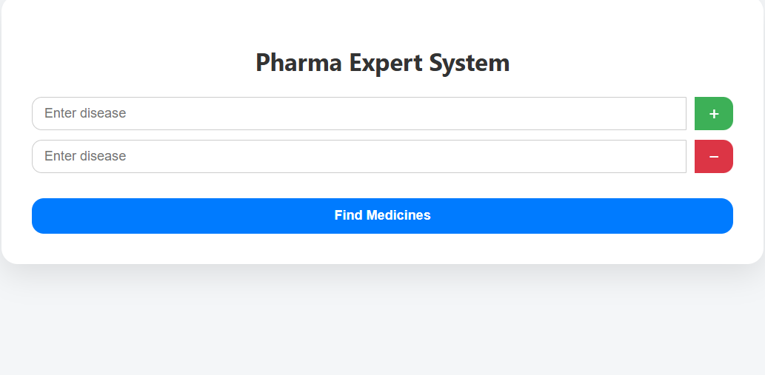
Interface

Slide 6
Working Mechanism
User Input
System Receives Query
Inference Engine Activated
Knowledge Base Consulted
Decision is Made
Result Displayed
Ready for New Query
Notes:
Inference Engine Activated
Compares the input with rules in the Knowledge Base.
Knowledge Base Consulted
Searches for matching conditions and recommended medicines.

Slide 7
Benefits
Saves Time
Improves Treatment Accuracy
Reduces Human Errors
Provides Expert Advice Anytime
Stores Medical Knowledge
Supports Doctors and Pharmacists
Cost-Effective
Secure Data Handling

Slide 8
Challenges & Limitations
Limited to stored knowledge
No human empathy
Errors if input is wrong
Struggles with complex cases
Not flexible with unclear queries
Needs regular updates for new medicines
Limited in understanding natural language input
Cost and time needed for development
Data privacy and security concerns
Notes:
No Human Empathy: The system can't understand feelings or offer emotional support like a real doctor. It gives logical answers, not compassionate care

Slide 9
Future Enhancements
Add voice input support
Use AI to learn from user feedback
Support for multiple languages
Real-time updates from medical databases
Add chatbot for smart conversation
Improve handling of complex cases
Strengthen data privacy and security

Slide 10
Conclusion
The Pharmacy Expert System improves accuracy, saves time, and supports medical decisions. With future upgrades, it can offer smarter, faster, and more secure healthcare solutions.
“Where AI meets care,
the future of pharmacy begins”

Slide 11
thank you
any question?

